Slide 1
Announcements
The final exam is in-class on Friday. It will be mainly multiple choice questions similar to the quizzes, and it will cover all of the assigned readings.
I’m holding an extra set of office hours tomorrow from 1:30-3:30 in 3401 Walnut room 452C.
HW5 is due on Tuesday, late days are OK to use.
Today’s lecture on Computer Vision is just for fun – it’s not on the exam.

Slide 2
Toward Deep Learning
Which of the following contain a face?
Can we approach the problem the same way we do for digits?
Notes:
let's think back to the interpretation of artificial neurons as a means of weighing evidence. Suppose we want to determine whether an image shows a human face or not:
We could attack this problem the same way we attacked handwriting recognition - by using the pixels in the image as input to a neural network, with the output from the network a single neuron indicating either "Yes, it's a face" or "No, it's not a face".

Slide 3
Toward Deep Learning
Notes:
Let's suppose we do this, but that we're not using a learning algorithm. Instead, we're going to try to design a network by hand, choosing appropriate weights and biases. How might we go about it? Forgetting neural networks entirely for the moment, a heuristic we could use is to decompose the problem into sub-problems: does the image have an eye in the top left? Does it have an eye in the top right? Does it have a nose in the middle? Does it have a mouth in the bottom middle? Is there hair on top? And so on.
If the answers to several of these questions are "yes", or even just "probably yes", then we'd conclude that the image is likely to be a face. Conversely, if the answers to most of the questions are "no", then the image probably isn't a face.
the heuristic suggests that if we can solve the sub-problems using neural networks, then perhaps we can build a neural network for face-detection, by combining the networks for the sub-problems. Here's a possible architecture, with rectangles denoting the sub-networks.

Slide 4
Toward Deep Learning
Notes:
It's also plausible that the sub-networks can be decomposed. Suppose we're considering the question: "Is there an eye in the top left?" This can be decomposed into questions such as: "Is there an eyebrow?"; "Are there eyelashes?"; "Is there an iris?"; and so on. Of course, these questions should really include positional information, as well - "Is the eyebrow in the top left, and above the iris?", that kind of thing - but let's keep it simple. The network to answer the question "Is there an eye in the top left?" can now be decomposed.

Slide 5
Notes:
Those questions too can be broken down, further and further through multiple layers. Ultimately, we'll be working with sub-networks that answer questions so simple they can easily be answered at the level of single pixels. Those questions might, for example, be about the presence or absence of very simple shapes at particular points in the image. Such questions can be answered by single neurons connected to the raw pixels in the image.

Slide 6
Notes:
The end result is a network which breaks down a very complicated question - does this image show a face or not - into very simple questions answerable at the level of single pixels. It does this through a series of many layers, with early layers answering very simple and specific questions about the input image, and later layers building up a hierarchy of ever more complex and abstract concepts. Networks with this kind of many-layer structure - two or more hidden layers - are called deep neural networks.
The end result is a network which breaks down a very complicated question - does this image show a face or not - into very simple questions answerable at the level of single pixels. It does this through a series of many layers, with early layers answering very simple and specific questions about the input image, and later layers building up a hierarchy of ever more complex and abstract concepts. Networks with this kind of many-layer structure - two or more hidden layers - are called deep neural networks.

Slide 7

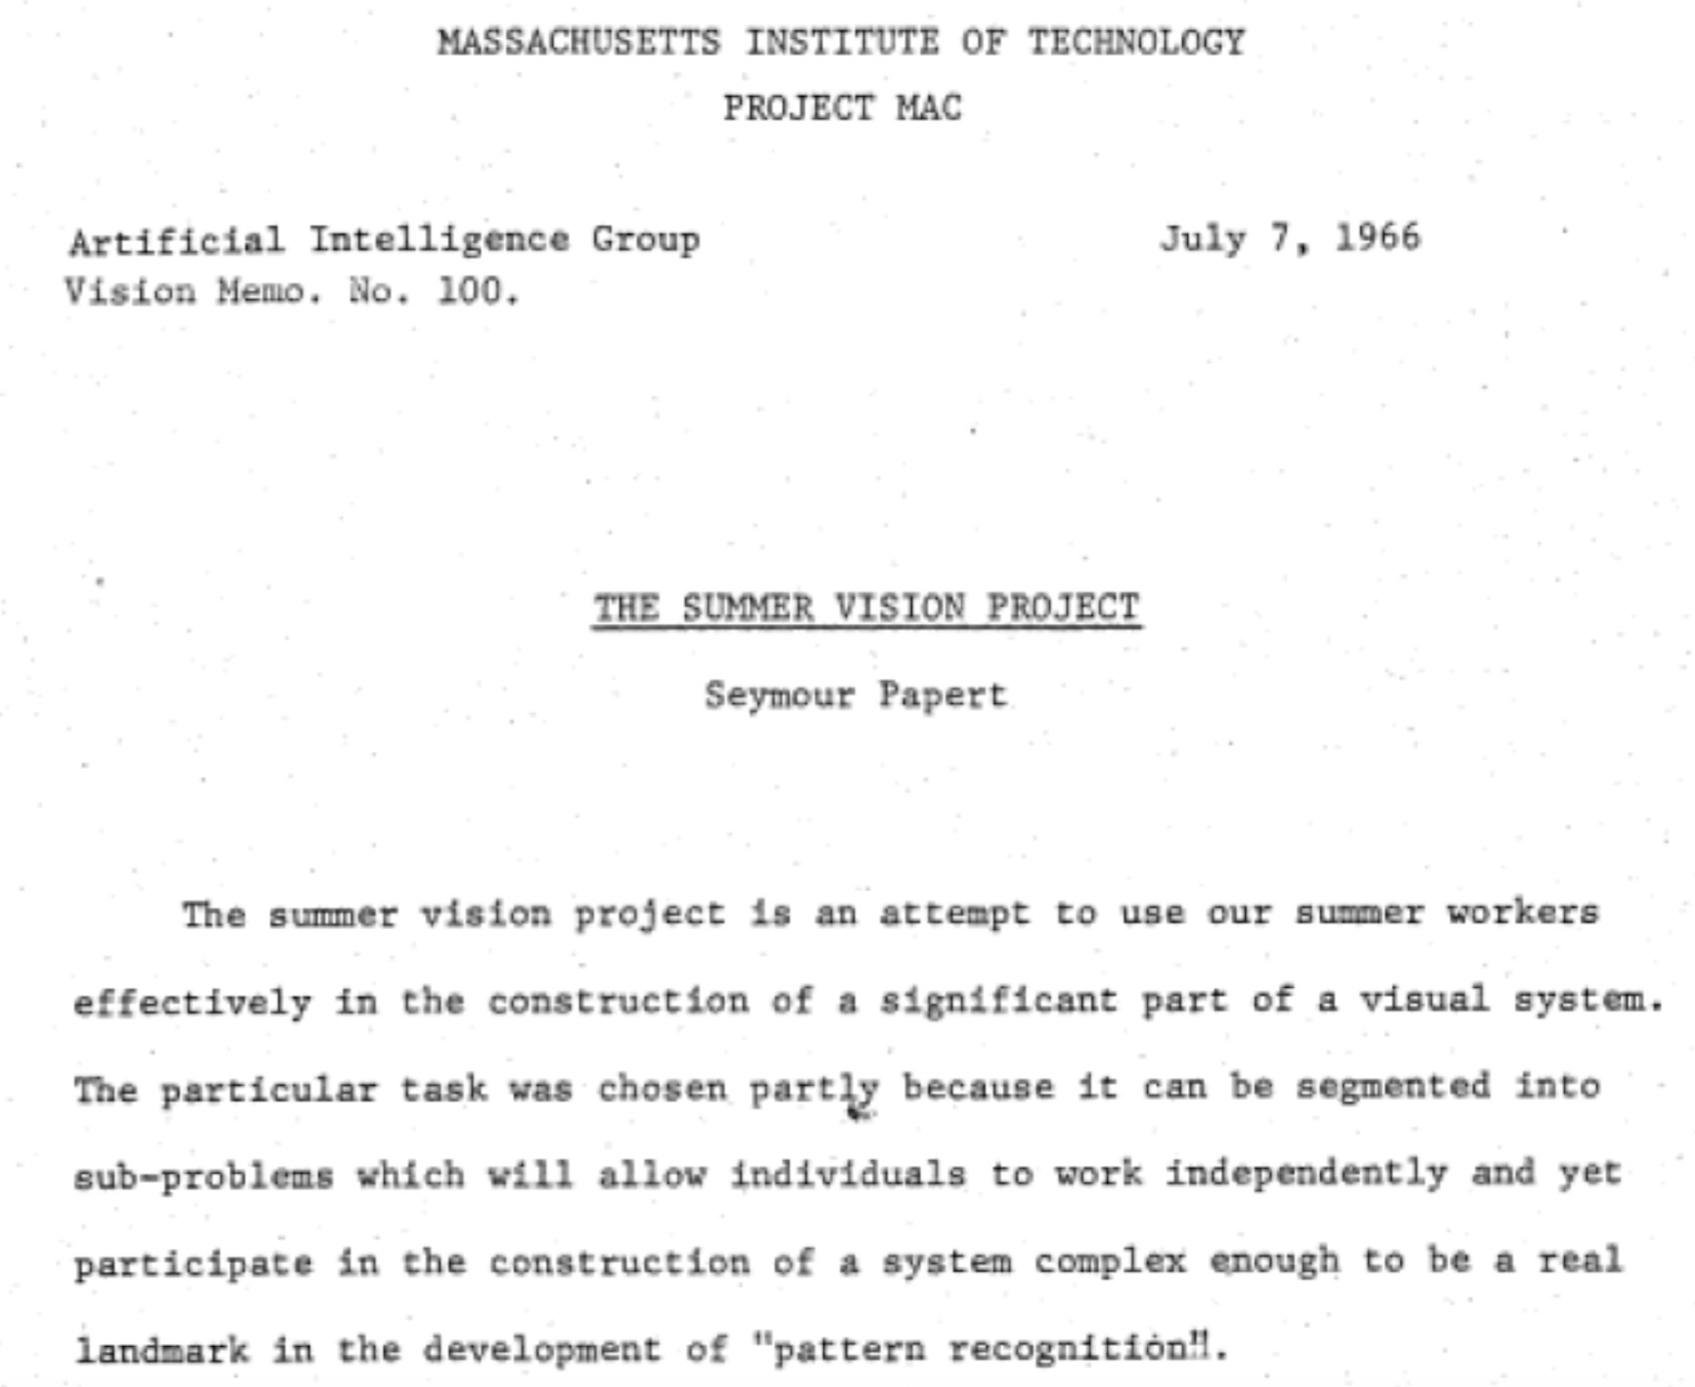
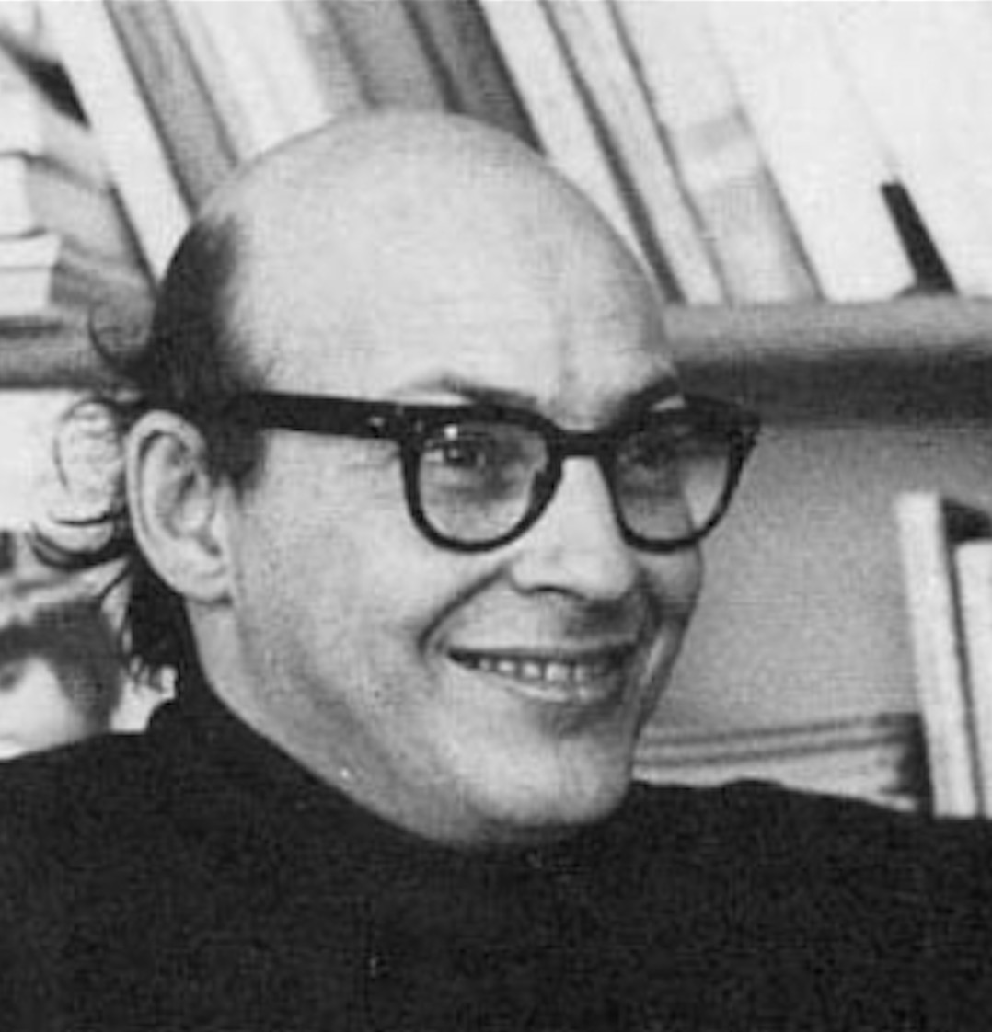
1966
“Connect a television camera to a computer and get the machine to describe what it sees.”
Marvin Minsky Turing award, 1969

Slide 8

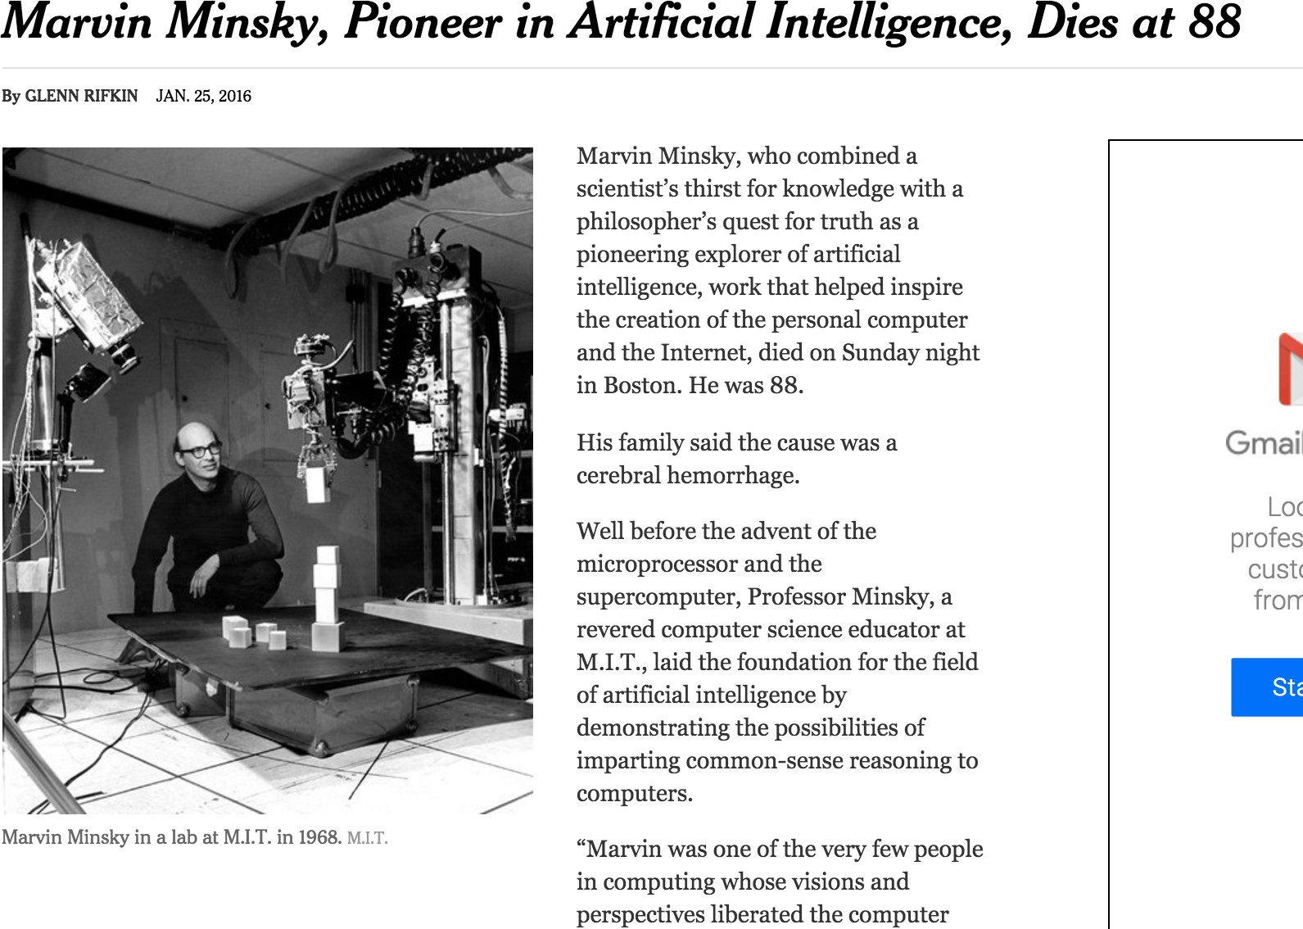

Slide 9
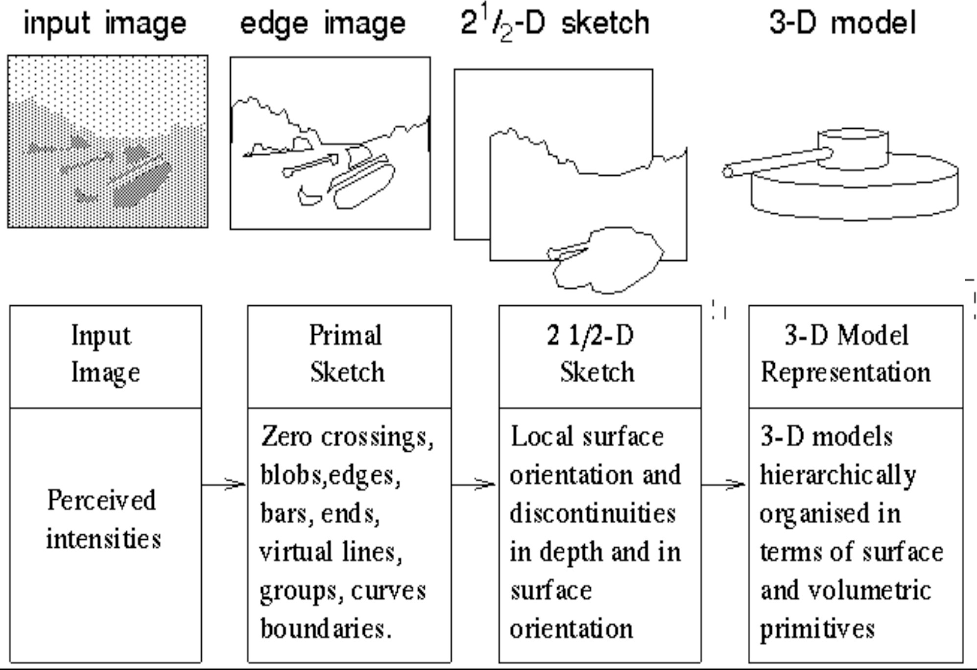
Stages of Visual Representation, David Marr, 1970

Slide 10
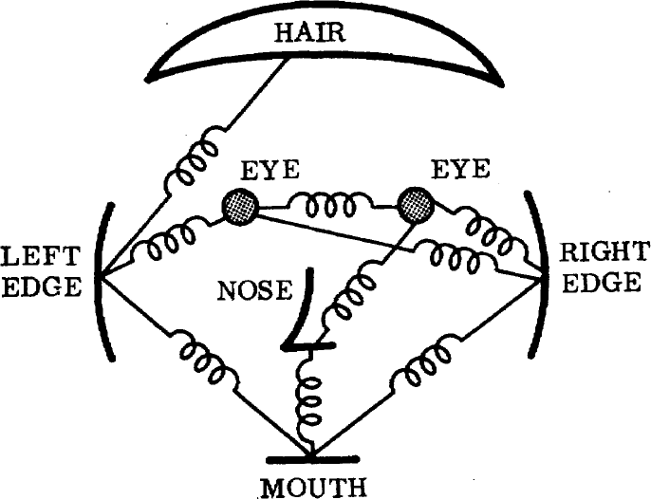
1973
The constellation model
The representation and matching of pictorial structures, Fischler and Elschlager, 1973

Slide 11
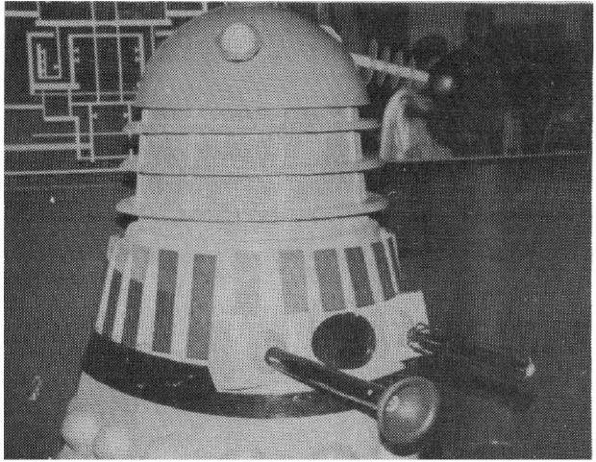
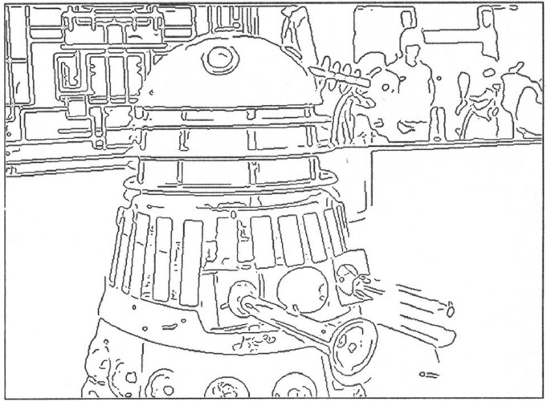
1980’s
AI winter…
…back to basics
A Computational Approach to Edge Detection, Canny 1986

Slide 12
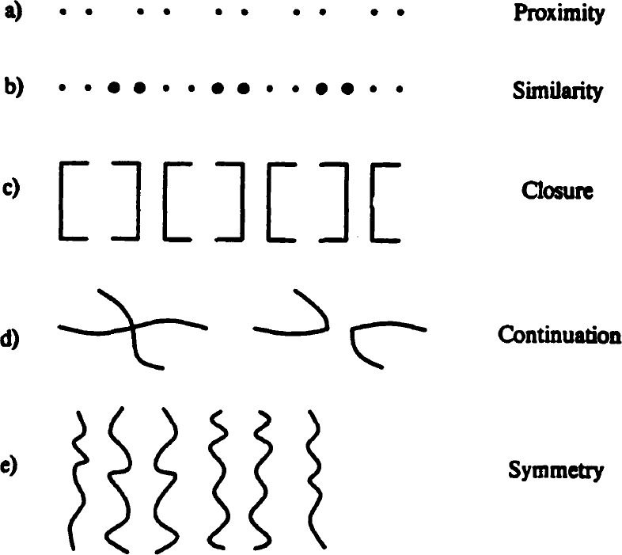
1984
Perceptual Organization and Visual Recognition, David Lowe, 1984

Slide 13
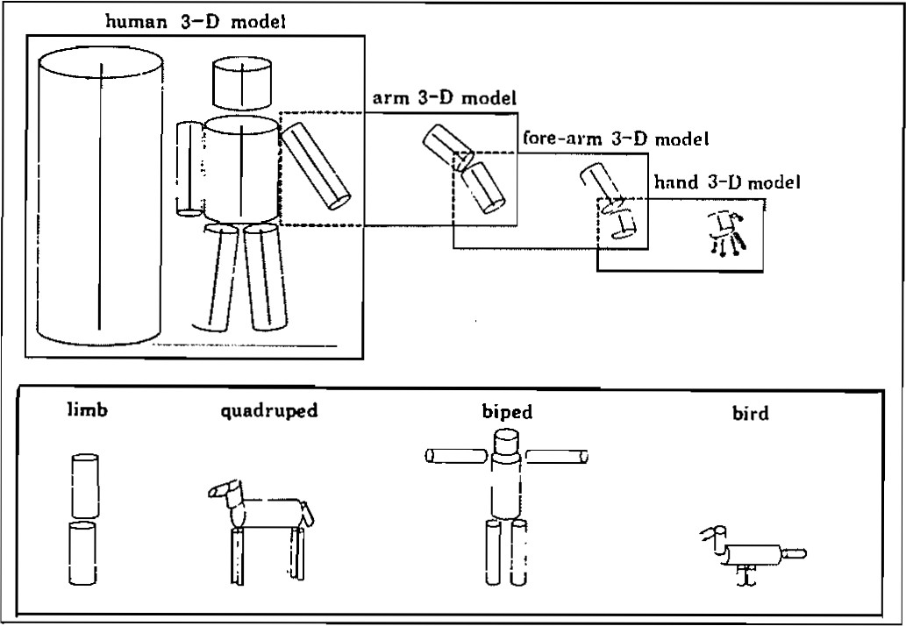
1986
Perceptual organization and the representation of natural form, Alex Pentland, 1986

Slide 14
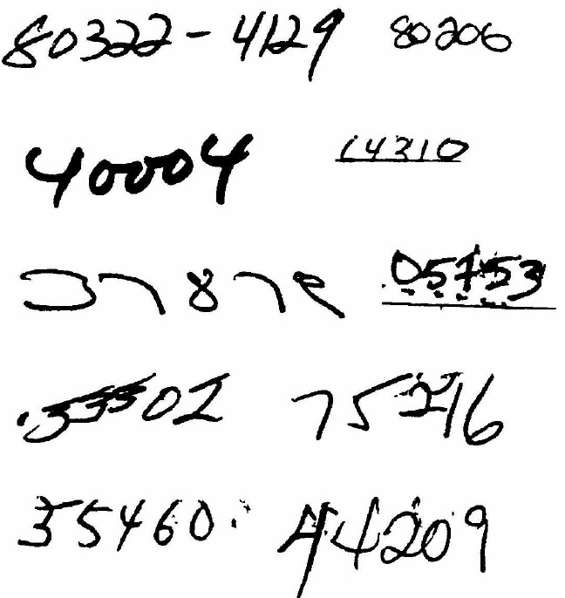
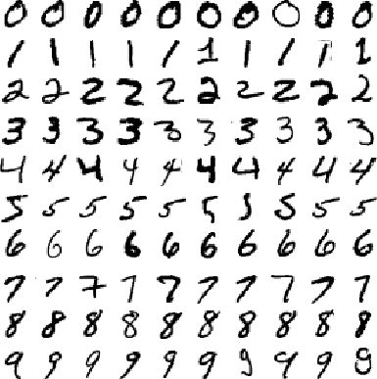
1989
MNIST
Zip codes
Backpropagation applied to handwritten zip code recognition, Lecun et al., 1989

Slide 15
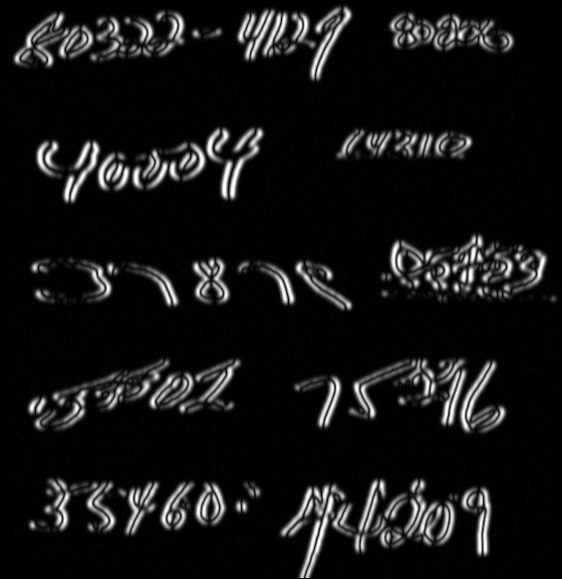
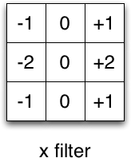
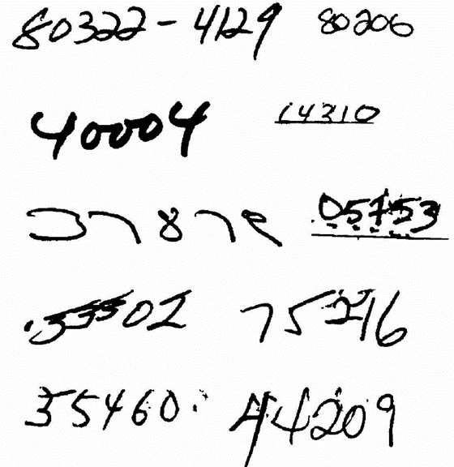
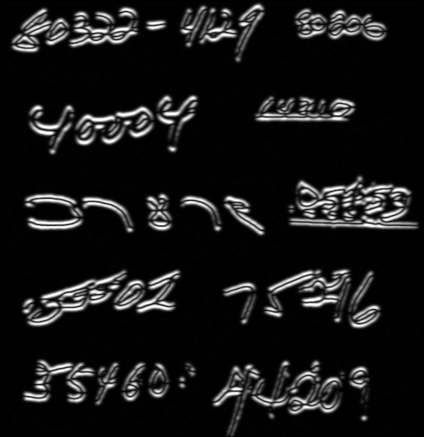
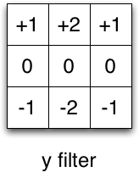
Filters
Input

Slide 16
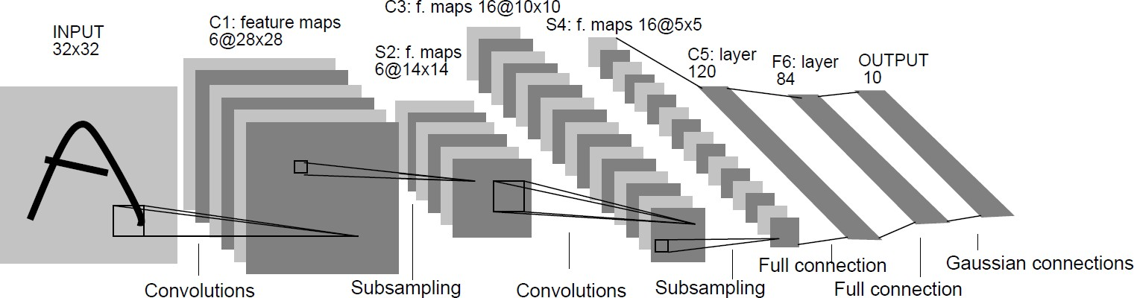
1989
Backpropagation applied to handwritten zip code recognition, Lecun et al., 1989

Slide 17
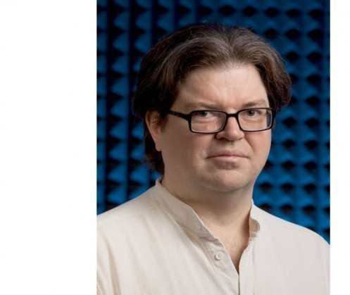
1989
Backpropagation applied to handwritten zip code recognition, Lecun et al., 1989

Slide 18
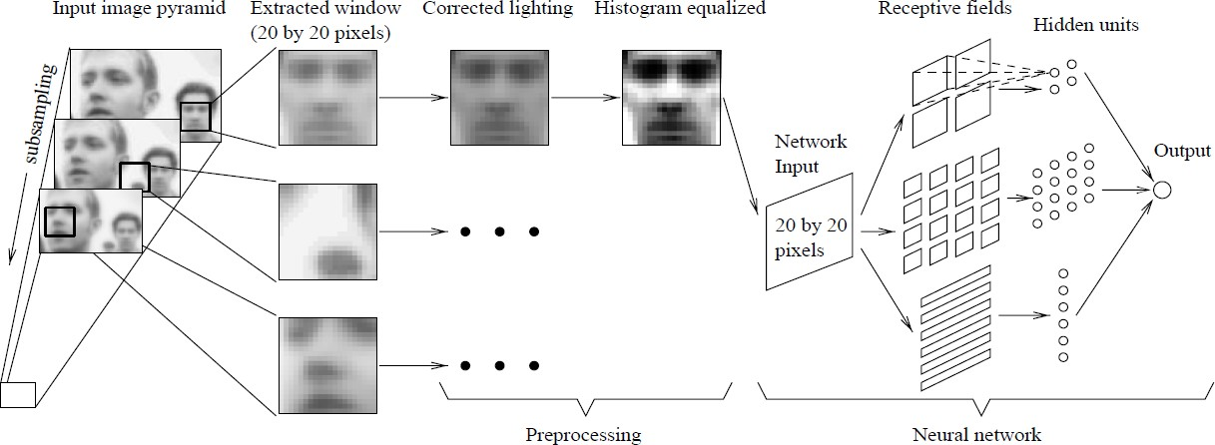
1998
Faces
Neural Network-­‐Based Face Detection, Rowley at al., PAMI 1998

Slide 19
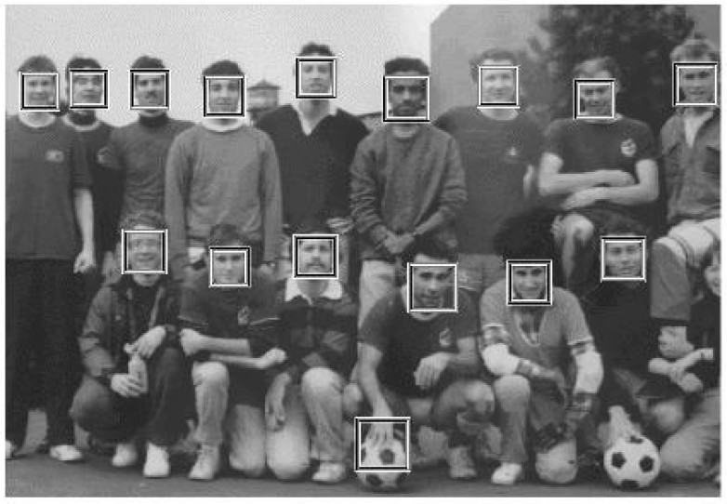
2001
Sliding window in real time!
Boosting + Cascade = Speed
Rapid Object Detection using a Boosted Cascade of Simple Features, Viola and Jones, CVPR 2001

Slide 20
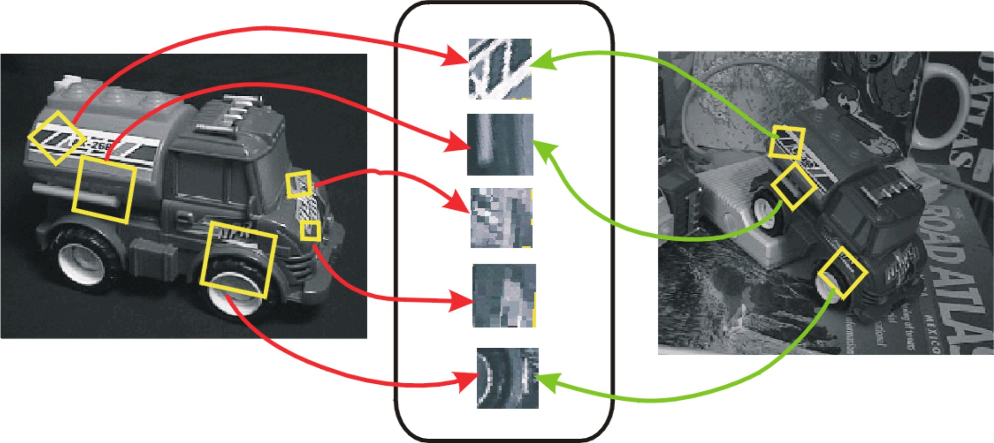
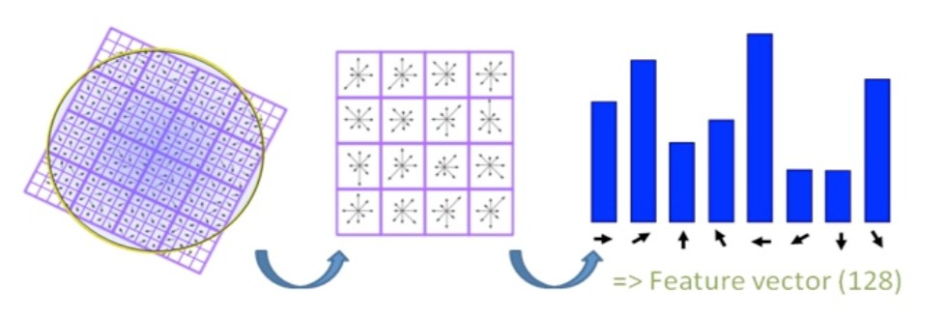
1999
SIFT
(Scale Invariant Feature Transform)
No more sliding windows (interest points) Better features (use more computation)
Object Recognition from Local Scale-­‐Invariant Features, Lowe, ICCV 1999.

Slide 21
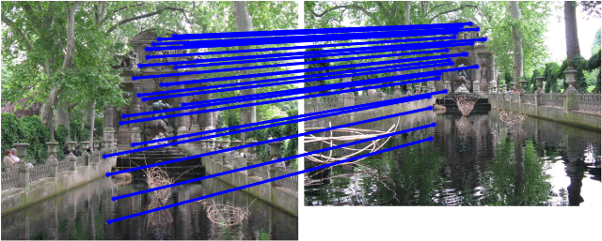
SIFT Matching
[SIFT: Lowe, 2004]

Slide 22
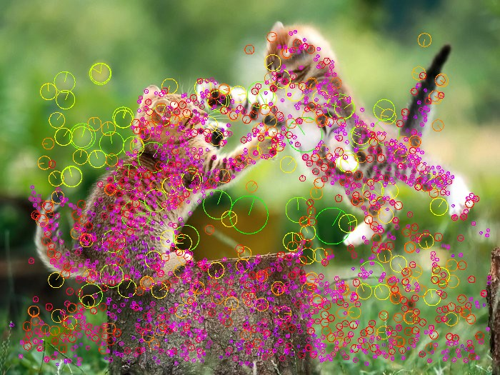
Interest points

Slide 23
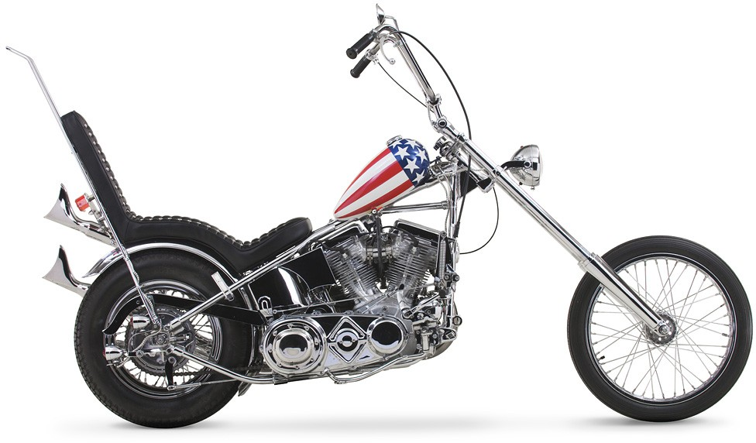


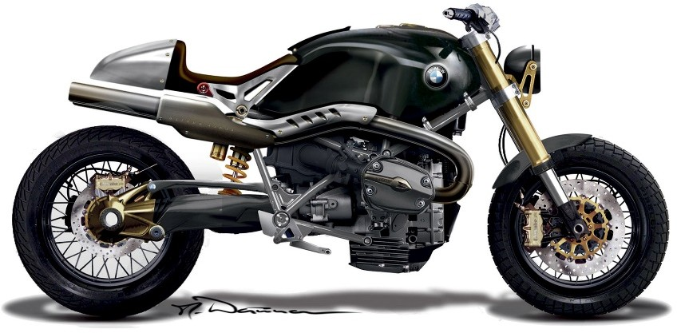





2003
Constellation model (redux)
Object Class Recognition by Unsupervised Scale-­‐Invariant Learning, Fergus et al., CVPR 2003.

Slide 24
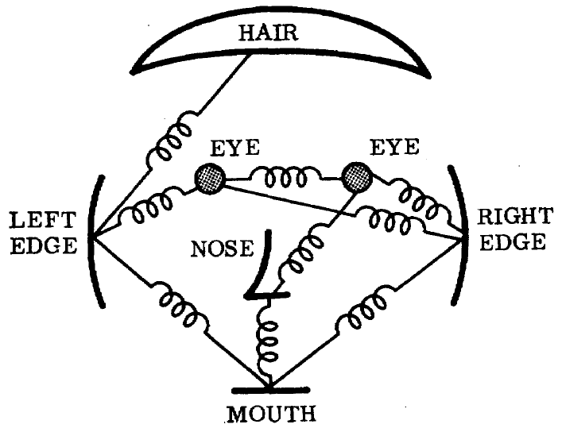
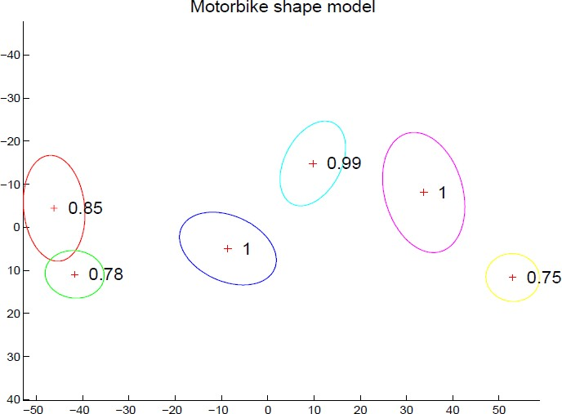
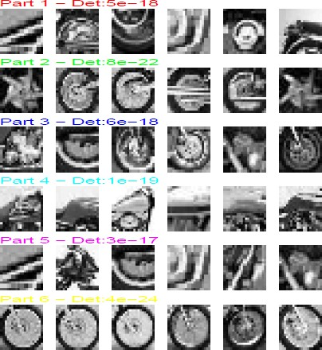
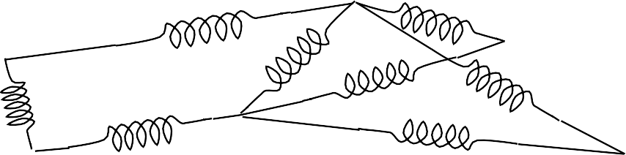
2003
Constellation model (redux)
The representation and matching of pictorial structures, Fischler and Elschlager, 1973
Joint Gaussian density

Slide 25
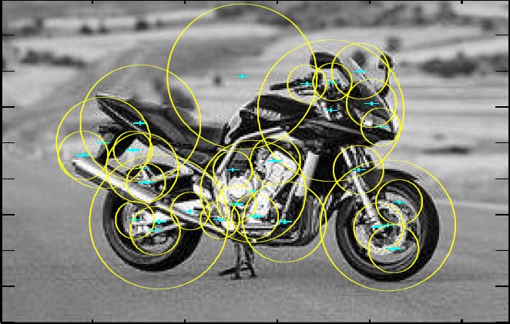
Interest points used to find parts:
Smaller number of candidate parts allows for more complex spatial models.

Slide 26
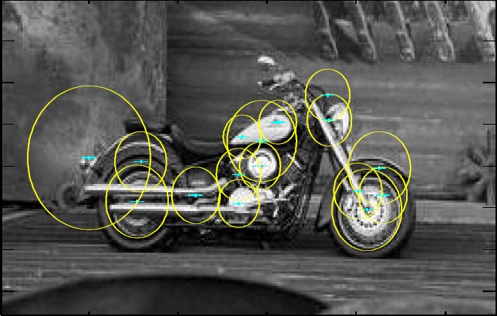
Why it fails
Interest points don’t work for category recognition

Slide 27
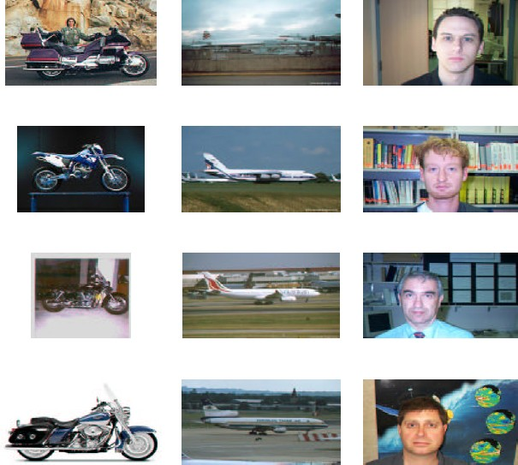
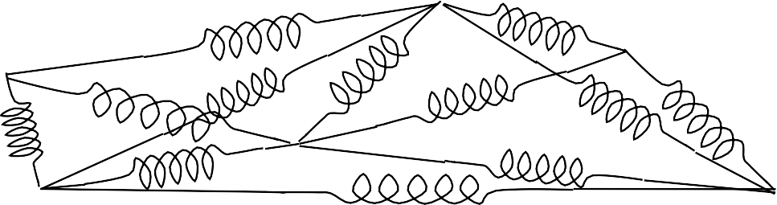
Too many springs…

Slide 28
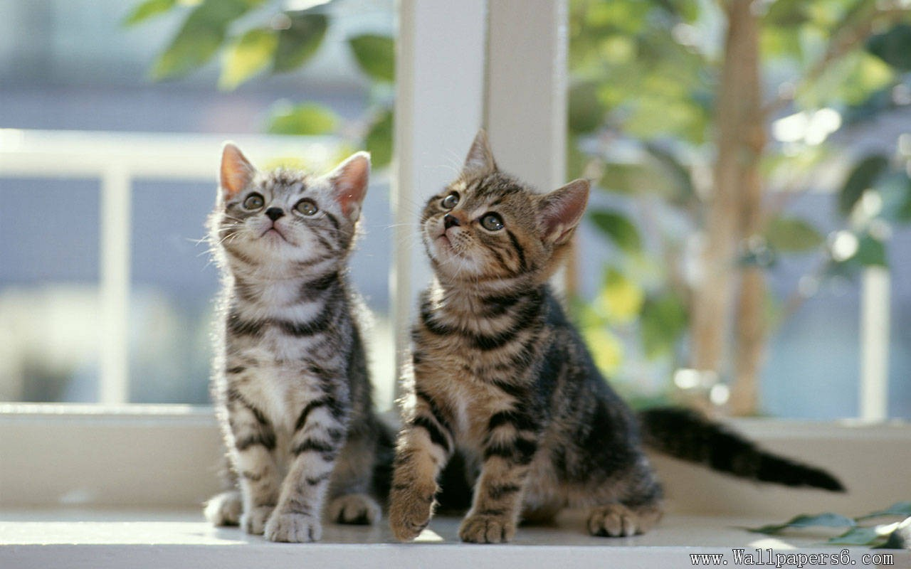
Classification
Vs.
Detection
✓✓ Cat
Cat
Cat

Slide 29
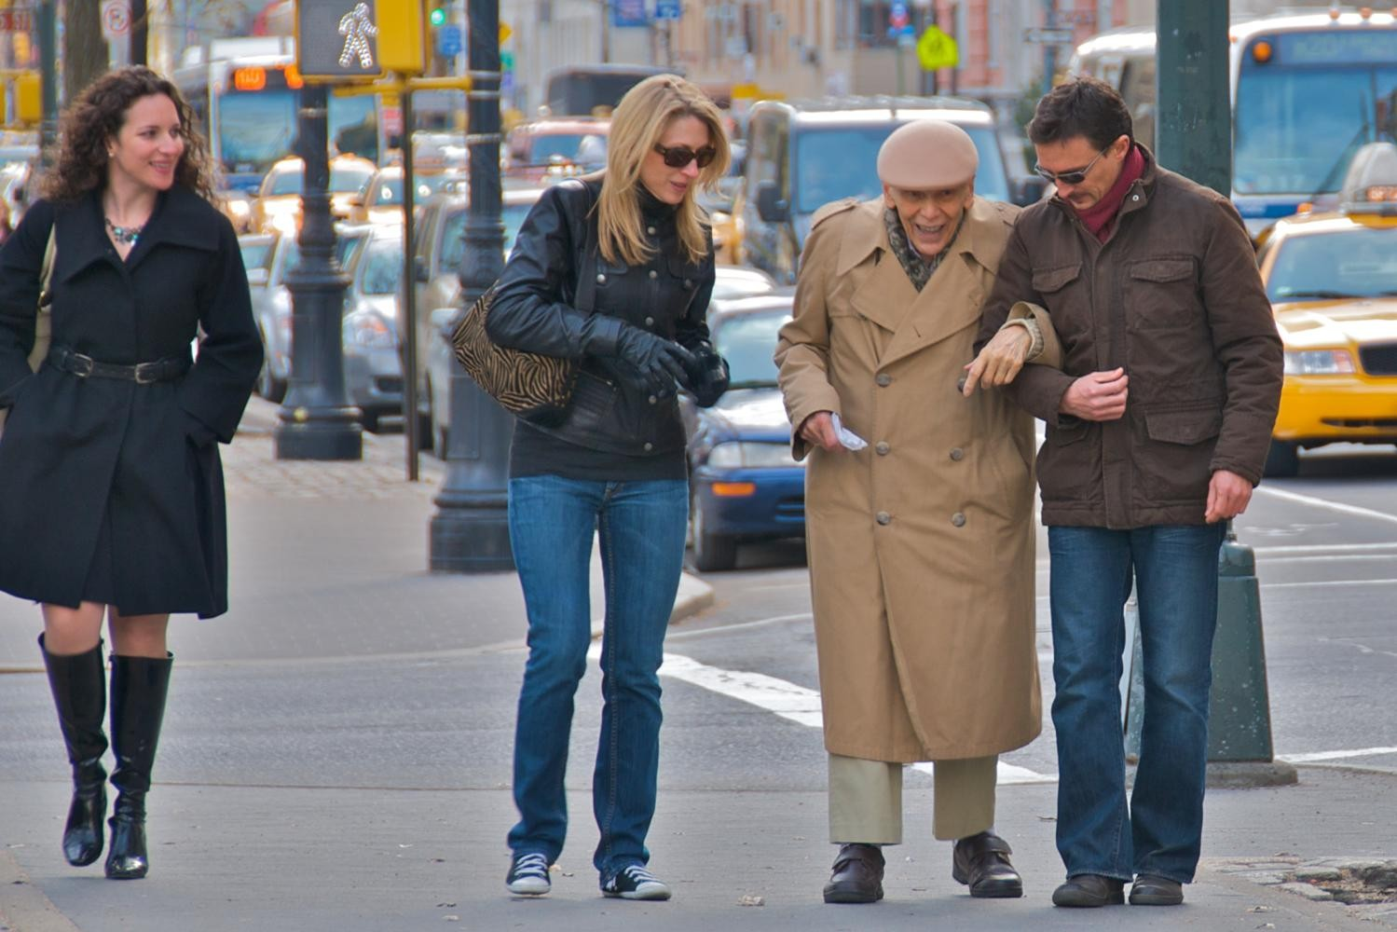
2005 HOG (histograms of oriented gradients)
Histograms of oriented gradients for human detection, Dalal and Triggs, CVPR 2005.

Slide 30
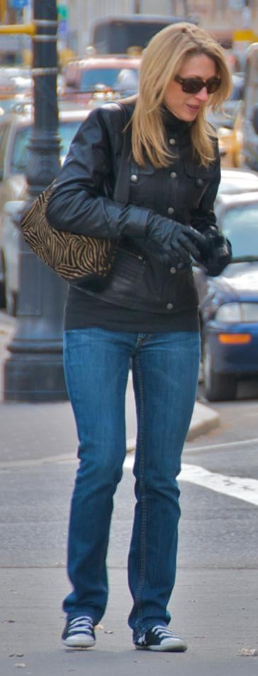
Pedestrians
Defined by their contours
Cluttered backgrounds
Significant variance in texture
Interest points won’t work…
…back to sliding window.

Slide 31

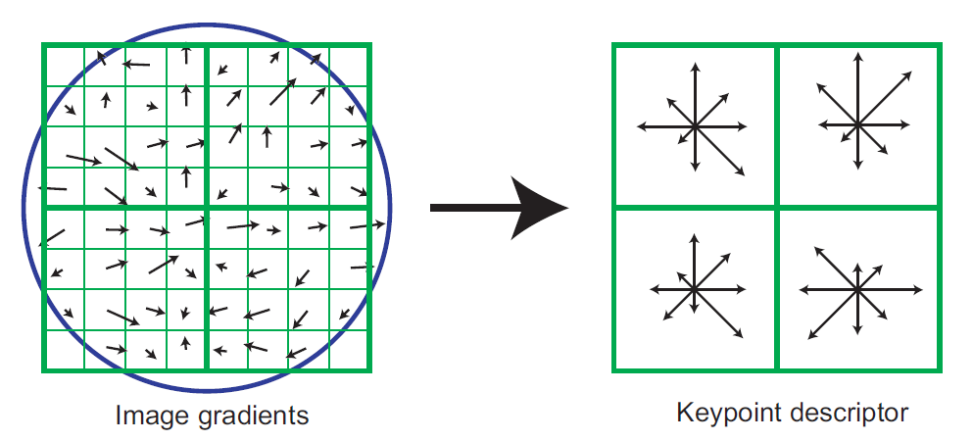
2005 HOG (histograms of oriented gradients)
SIFT

Slide 32
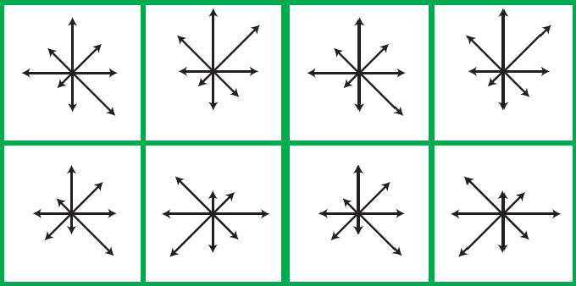
2005 HOG (histograms of oriented gradients)
Histograms of oriented gradients for human detection, Dalal and Triggs, CVPR 2005.

Slide 33
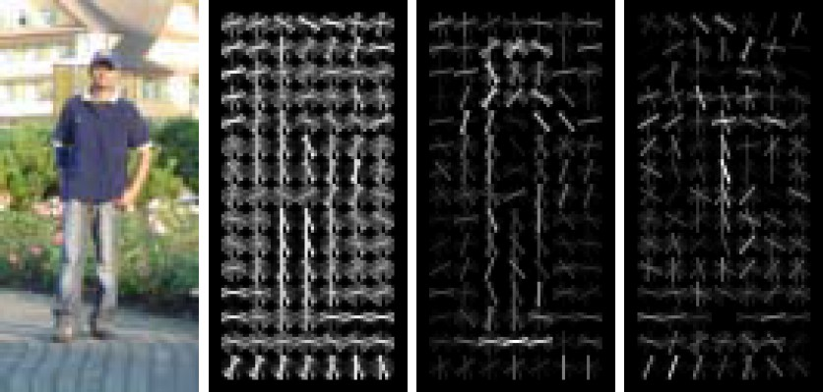
2005 HOG (histograms of oriented gradients)
Presence > Magnitude
✓✓ Normalization by a local window
Notes:
We can finally detect object boundaries in a reliable manner!
Hard negative mining Computers are fast enough.

Slide 34
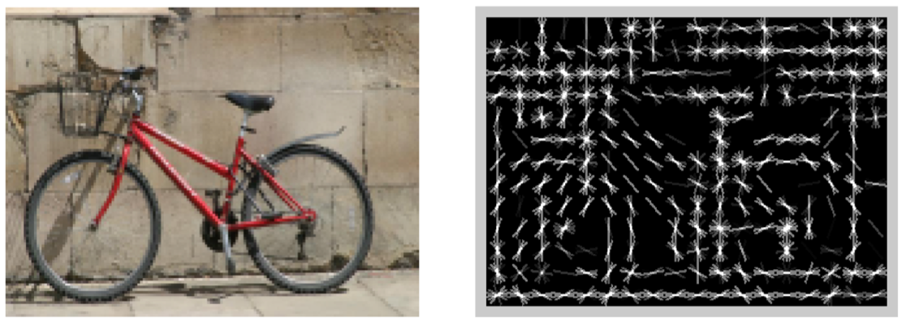
What’s this?
[Dalal and Triggs, 2005]

Slide 35
Yup.
Image
HoG

Slide 36
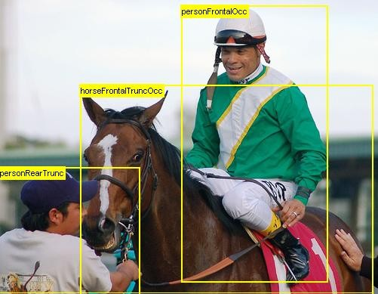
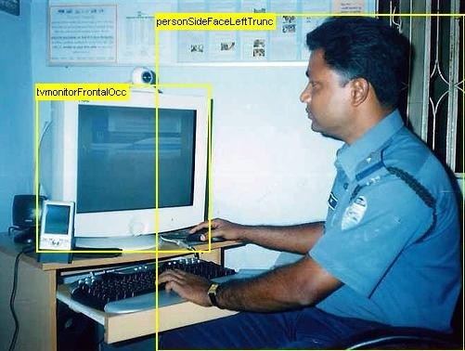
2007 PASCAL VOC
20 classes
The PASCAL Visual Object Classes (VOC) Challenge, Everingham, Van Gool, Williams, Winn and Zisserman, IJCV, 2010

Slide 37

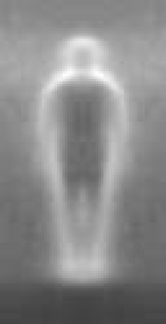
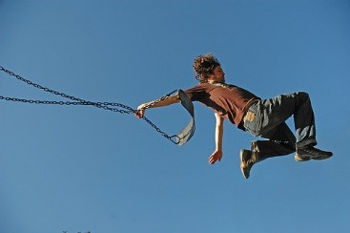

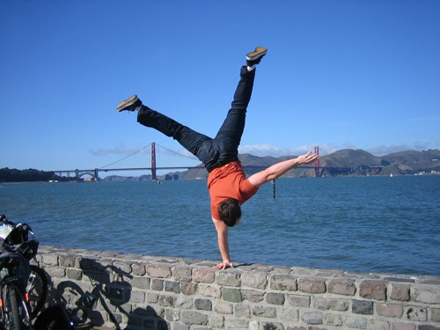
Why it is hard

Slide 38
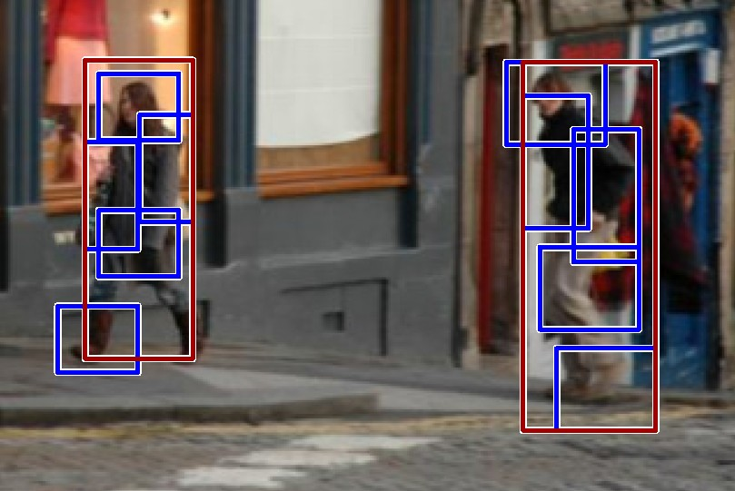
2008 DPM (Deformable parts model)
Object Detection with Discriminatively Trained Part Based Model,
Felzenszwalb, Girshick, McAllester and Ramanan, PAMI, 2010

Slide 39
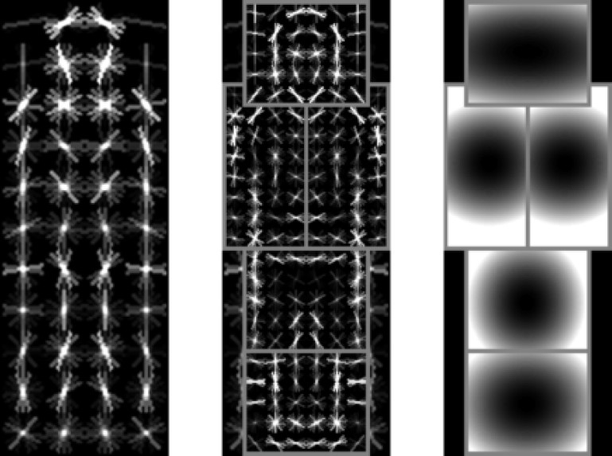
2008 DPM (Deformable parts model)
Object Detection with Discriminatively Trained Part Based Model,
Felzenszwalb, Girshick, McAllester and Ramanan, PAMI, 2010

Slide 40
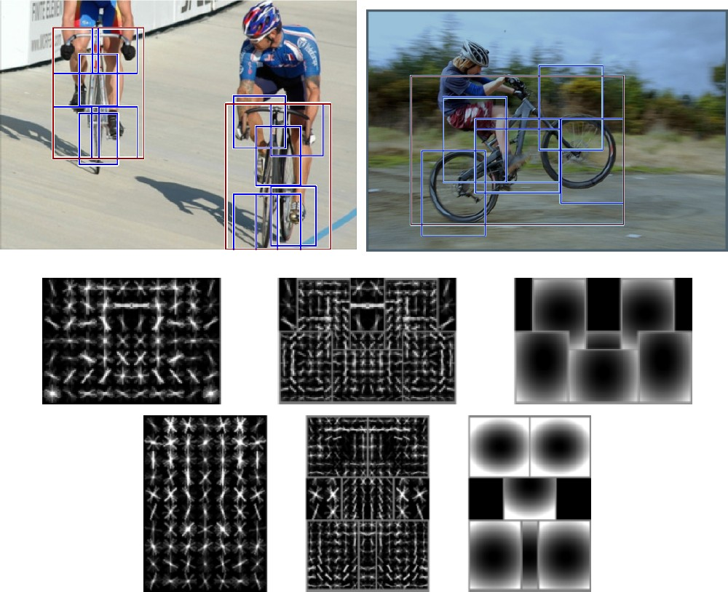
Multiple components
Notes:
Multiple components
Deformable parts?
Hard negative mining
Good balance

Slide 41
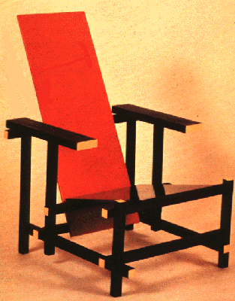






Problems with Visual Categories
A lot of categories are functional
Char
World is too varied
car
Categories are 3D, but images are 2D
57

Slide 42

Do We Need More Training Data or Better Models for Object Detection?
Zhu, Vondrick, Ramanan, Fowlkes, BMVC 2012.

Slide 43


Slide 44


2009 ImageNet
22K categories, 14M images Corgi
Orb weaving spider
ImageNet: A Large-­‐Scale Hierarchical Image Database,
Deng, Dong, Socher, Li, Li and Fei-­‐Fei, CVPR, 2009

Slide 45



Images
2009
2012
14M
ImageNet

Slide 46


Categories
2009
2012
22K
ImageNet

Slide 47



Algorithms
2012
Dense
Dense
Dense
2009
Convolution
Convolution
Pooling
Convolution
SVM
Convolution
HOG
Convolution
Image
Image

Slide 48


Slide 49


Slide 50


Slide 51


Slide 52


Slide 53


Slide 54


Slide 55


Slide 56


Going beyond categorization…
“Connect a television camera to a computer and get the machine to describe what it sees.”

Slide 57

Going beyond categorization…
“Connect a television camera to a computer and get the machine to describe what it sees.”

Slide 58

Going beyond categorization…
“Connect a television camera to a computer and get the machine to describe what it sees.”

Slide 59


Going beyond categorization…

Slide 60



Slide 61
1966
“Connect a television camera to a computer and get the machine to describe what it sees.”
Marvin Minsky Turing award, 1969

Slide 62

Notes:
https://www.youtube.com/watch?v=R2mC-NUAmMk

